Slide 1
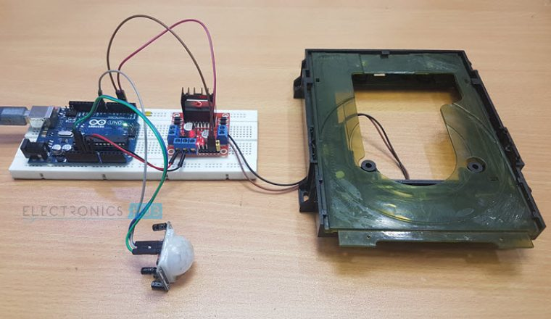
Automatic Door Opening System

Slide 2

PREPARED BY:
Dipesh Jadhav [T-625]
Akshay Kalapgar [T-631]
Mohit Kamble [T-632]
(Students)

Slide 3
You must have seen automatic door openers in shopping malls and other commercial buildings. They open the door when someone comes near the entrance and close it after sometime. A number of technologies are available to make such kinds of systems like IR sensors, Radar sensors, Laser sensors, Infrared sensors, etc. In this arduino based project, we have tried to replicate the same system by using a IR sensor. It uses a motion-detecting sensor (IR sensor) to open or close the door which detects the infrared energy omitted from human's body. When someone comes in front of the door, the infrared energy detected by the sensor changes and it triggers the sensor to open the door whenever someone approaches the door. The signal is further sent to arduino uno that controls the door.
Introduction

Slide 4
Principle of the Project
An Automatic Door Opener System is a simple project based on IR Sensor and Arduino, which automatically opens and closes the door by detecting a person or object.
You might have seen Automatic Door Opener Systems at shopping malls, cinemas, hospitals etc. where, as soon as a person approaches the door (at about 2 or 3 feet), the door automatically slides open. And after some time (about 5 to 10 seconds), the door closes by sliding in the reverse direction.
Such Automatic Door Opener Systems are very useful as you do not need a person to standby the door and open it whenever a guest comes. Also, since the doors are opened and closed only when a person approaches the door, there is significantly less loss of air conditioning.
So, in order to understand the potential of this concept, we have implemented a simple Automatic Door Opener System using Arduino and IR Sensor.

Slide 5
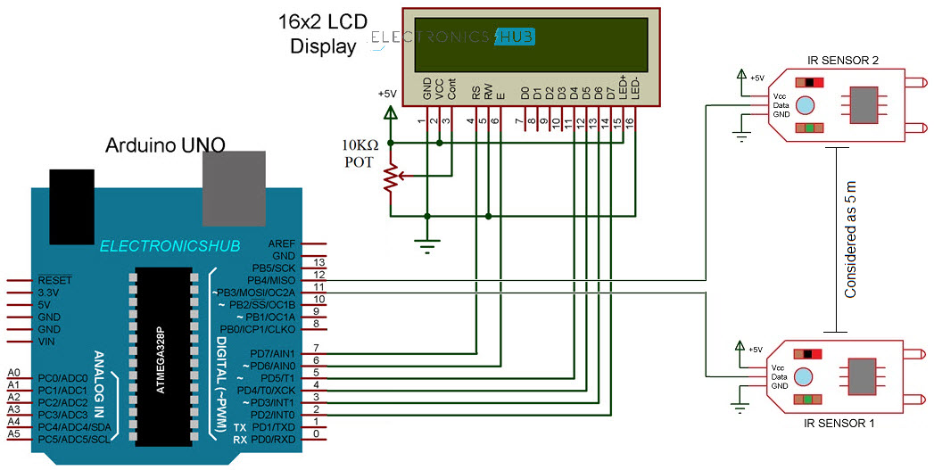
Circuit Diagram of Arduino Car Speed Detector
The following image shows the circuit diagram of the Automatic Door Opening System.

Slide 6
Components Required
Arduino UNO
IR Sensor
L298N Motor Driver Module
CD Tray with 5V Motor
Breadboard
Connecting Wires
Power Supply

Slide 7
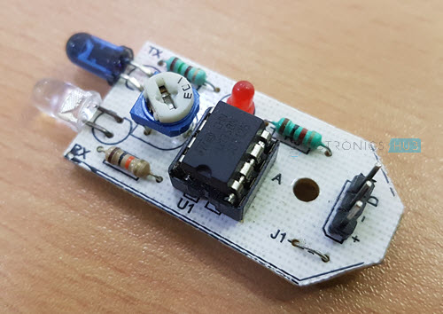
A Brief Note on IR Sensor
First of all, I have used two digital IR Sensors, which consists of an IR Transmitter (IR LED), an IR Receiver (Photo Diode), a Comparator IC and a few supporting components. The IR Transmitter and Receiver Pair are placed side-by-side so that they form a Reflective Type IR Sensor.
In this type, the IR Transmitter continuously emits Infrared radiations and if there is no object in front of the sensor, none of the Infrared radiation gets reflected back to the IR Receiver.
But if there is an object in front of the sensor, some of the infrared radiation hits the object and gets reflected back. This reflected radiation falls on the IR Receiver, which means that the sensor has detected the object.
Some IR Sensors has the option to produce both Analog and Digital Outputs but the module I have used has only Digital Output i.e. the output is HIGH when an object is detected and LOW when there is no object.

Slide 8
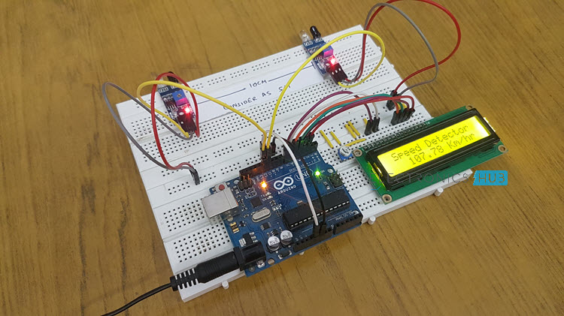
Circuit Design
The Digital OUT of the first IR Sensor is connected to Pin 11 of Arduino and the Digital OUT of the second IR Sensor is connected to Pin 12 of Arduino. Both the IR Sensors are provided with necessary power supply connections.
In order to view the car speed details, I have used a 16×2 LCD. Its data pins i.e. D4 – D7 are connected to Digital I/O pins 5 – 2. The RS and E pins of LCD are connected to pins 7 and 6 of Arduino. Rest of the connections are mentioned in the circuit diagram.

Slide 9
Code
How to operate Automatic Door Opening System?
Make all the necessary connections with respect to the circuit diagram and upload the code to Arduino.
Place the two IR Sensors on the edge of the breadboard so that the distance between them is approximately 10 centimeters.
Simulate a movement in front of the sensors either by using your hands or a object.
Arduino calculates the speed and displays the result on the 16×2 LCD.

Slide 10
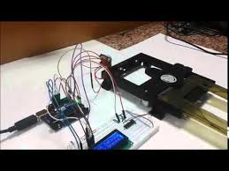
Working
The working of the Automatic Door Opener System using Arduino and IR Sensor is very simple. This project can be considered as an extension of Arduino IR Sensor Tutorial and Arduino L298N DC Motor Control Tutorial
When the IR Sensor detects any motion of a person, its Data OUT Pin will become HIGH. As this pin is connected to the Arduino, it will detect this HIGH Signal and understands that there is person approaching the door.
Arduino then immediately activates the L298N Motor Driver module to open the door. After some time (about 2 to 5 seconds in this project), the Arduino will once again activate the Motor Drive to close the door.

Slide 11
Applications
Arduino based Automatic Door Opener System is a very useful project as it enables you to understand the concept of such automatic door opener systems and how they work.
These systems are already being used in many places like malls, theatres and hospitals.
You can implement this Arduino based project at you home in Garage Door Openers, toilet cover openers, Office door openers, etc.

Slide 12
CONCLUSION
This project is a simple design of automatic door opening system where IR sensor serves the main input function and here arduino uno is a microcontroller board based on the ATmega328p.
We’ve considered two feedbacks to this architecture that when we implement an effective system then there can be a display unit for showing number of persons entered in a particular room along with this system we can use face-detection through camera for automated attendance system
Thus, we can conclude that this is a simple and low cost architecture of automatic door opening system but having lots of benefits such as we can conserve energy, reduces human efforts, saves time, etc.

